Slide 1
Australia’s Security of Critical Infrastructure Act 2022 Dr Dominique Dalla-Pozza Senior Lecturer, Law School, ANU College of Law Dominique.Dalla-Pozza@anu.edu.au
National Security College, The Australian National University
Understanding Risk
18 March 2022

Slide 2
Overview of this session
2:00 – 3:15 pm
Interactive lecture + Q&A session
Please ask questions as we go, but I will leave 10 minutes or so time for questions at the end.
3:15- 3:45 BREAK
3:45- 4:45
Discussion and Group Activity (instructions on the last slide of this presentation

Slide 3
Topics covered in the interactive lecture
First session 2:00 – 3:00
Interactive Lecture covering the following
Introduction of two key ideas in the debate about critical infrastructure (especially in a cyber enabled world)
‘national security’ and ‘national resilience’ - and how they relate to each other
The current ‘threats’ facing Australia’s critical infrastructure
The way in which the Current domestic legal framework which aims to deal with threats to critical infrastructure developed (the legislative process point)
And last (but not least) Key features of the current legal framework which aims to deal with national security risks to critical infrastructure with an emphasis on the provisions which are directed towards managing cyber risks
Security of Critical Infrastructure Act 2018 (Cth)
(which currently includes substantial amendments made by the Security Legislation Amendment (Critical Infrastructure) Act 2021 ( which came into force on 2 December 2021)
And the Security Legislation Amendment (Critical Infrastructure Protection) Act 2022 (which came into force on 2 April 2022)

Slide 4
‘National Resilience’ and ‘National Security’ Overlaps and Differences
These ideas are taken from the article by Christian Fjäder, ‘The National State, National Security and Resilience in the age of globalisation’ (2014) Resilience Vol 2(2) 114- 129
Governments (including the Australian government) have shifted towards talking about ‘resilience’ as part of their security strategy (see pp 118-119)

Slide 5
What is ‘National Resilience’ ?
Fjäder acknowledges that ‘there is no single definition of ‘resilience’
One set of understandings applies when we are talking about an ‘individual, a single system or otherwise clearly defined entity’.
In this context it means the ability to ‘withstand and recover…from shocks’ (p 120). But to assess this idea means you have to be able to identify what is the ‘normal’ state that the individual/single system needs to maintain/return to.

Slide 6
But what about ‘societal resilience’
‘In general, it appears that the national resilience , security and CIP [critical infrastructure protection] strategies reviewed…[in this article] have a tendency to declare very broad objectives, aiming at building a ‘resilient country’ that is able to withstand and recover from disasters and any unexpected events (the ‘all hazards’ approach’. This … is not adequate, especially in terms of determining whether resilience has indeed been established, to what exactly and to what extent’ (Fjäder, 2014, 121 emphasis added).

Slide 7
Key differences between ‘security’ and ‘resilience’
To Fjäder, ‘security’
‘is essentially preventative and proactive in nature’ (p 122). The aim is to try and stop ‘the threat’ or in a ‘worst case to defeat it as soon as possible’ (p 123)
‘focuses on protecting something ‘relatively specific’ - people, specific territory or specific facilities’
In some senses whether we have obtained security can be ‘verifi[ed]’ (p 123)

Slide 8
Key differences between ‘security’ and ‘resilience’
By contrast Fjäder says ‘resilience’
Presupposes that a society hasn’t been fully successful at obtaining ‘security’ so ‘it focuses on minimising disruption to critical services to society once an event has…happened’ (p 123)
It has both ‘proactive and reactive’ elements. The ‘aim’ is not necessarily completely preventative.
‘resilience’ is linked to an ‘all hazards’ approach
The focus is less specific - ‘ a complex system’ can (ideally) be made more resilient
The idea is not to ‘defeat’ a threat, but ‘to adapt to disruptions and recover from them’ (p 123)
Problem: how do you verify when this has been achieved.

Slide 9
Another key difference: what is the role of the ‘state’? (Again Fjäder)
For ‘national security’ (at least traditionally) this is an area where government/ the state has been dominant
But providing protection (ie security) to all critical infrastructure is increasingly not something the government can do on its own. So there is an increased, and qualitatively different role for industry/civil society here

Slide 10
A final thought from Fjäder
‘Taking into consideration that resilience, in the context of national security, has emerged, at least partially because of the importance placed on 'new' threats (for example, economic, societal and environmental threats), emphasising resilience and an all hazards approach, instead of traditional preventive security, can be seen as an entirely pragmatic response. The application resilience in this context, however, requires the nation-state to agree on a new social contract with citizens based on mutual understanding that acknowledges at least a partial shift from prevention of threats to management of the impact of threats. (p 128, emphasis added)

Slide 11
Policy Definitions of ‘critical infrastructure from the Australian Government
Critical infrastructure is:
'Those physical facilities, supply chains, information technologies and communications networks which, if destroyed, degraded or rendered unavailable for an extended period, would significantly impact the social or economic well-being of the nation or affect Australia's ability to conduct national defence and ensure national security'.
The Australian Government’s Critical Infrastructure Resilience Strategy: Plan (2015) https://cicentre.gov.au/document/P50S021 pp 1(emphasis added)

Slide 12
What has the Government said about this?
‘Critical infrastructure is increasingly interconnected and interdependent. These interconnections deliver efficiencies and economic benefits to all Australians. However, connectivity without proper safeguards creates vulnerabilities that can deliberately or even inadvertently cause disruption and result in cascading consequences across our economy, our security and our sovereignty.
Threats ranging from natural hazards, such as extreme weather events, through to human induced threats like foreign interference, cyberattacks and trusted insiders all have the potential to significantly disrupt critical infrastructure. Recent incidents such as the December 2021 Log4j vulnerability, compromising systems in Australia and across the globe, as well as the impacts of COVID-19, illustrate that threats to the operation of Australia's critical infrastructure continue to be significant and far-reaching.’
- The Hon Karen Andrews MP, Minister for Home Affairs, Proof House of Representatives Hansard, 10 February 2022, p. 15 quoted by the Parliamentary Joint Committee on Intelligence and Security, Advisory Report on the Security Legislation Amendment (Critical Infrastructure Protection) Bill 2022 para 1.2

Slide 13
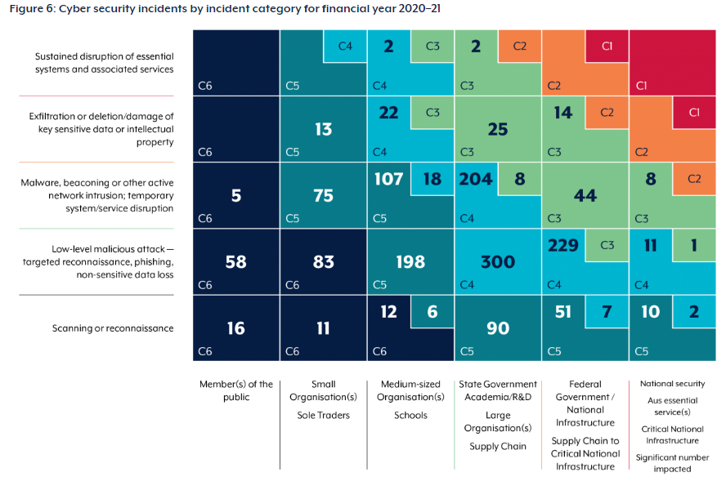
The current ‘cyber threat environment’ in relation to Critical Infrastructure This data comes from the ACSC Annual Cyber Threat Report 1 July 2020 – 30 June 2021 (p 19) https://www.cyber.gov.au/acsc/view-all-content/reports-and-statistics/acsc-annual-cyber-threat-report-2020-21

Slide 14
So what has government been doing? Quite a bit - and in the last two years some significant change in domestic legislation
Protecting Critical Infrastructure and Systems of National Significance Consultation Paper (2020)
Important aspects of this document
Clear shift towards an ‘all-hazards’ approach
An understanding that Australian critical infrastructure is vulnerable to many different types of threats
From the ‘conventional’ national security threats posed by foreign interference and terrorism
To the threats posed by non-human events (such as pandemics and bushfires)

Slide 15
Protecting Critical Infrastructure and Systems of National Significance Consultation Paper (2020)
Further acknowledgement of the different relationship between government and non-government entities in this space
‘A cohesive partnership between government and industry, especially through sharing of technical expertise, is a desirable end state. Collective action now will place Australia in the best position to combat both foreseeable and emerging risks. The enhanced framework will meet this need, supported by proportionate sector specific standards‘ (Protecting Critical Infrastructure and Systems of National Significance Consultation Paper (2020) p 6)

Slide 16
Legislation to protect Australia’s Critical Infrastructure

Slide 17
A key piece of legislation
Security of Critical Infrastructure Act 2018 (Cth).
But it has been significantly changed

Slide 18
How did we get to the current law: (the Parliamentary process)
This Bill had a really interesting development (prior to being introduced to Parliament)
Described as ‘a long and circuitous journey’ (Gilbert +Tobin The Curtain Falls – Final Reforms to Australia’s Critical Infrastructure Laws 31 March 2022) (https://www.gtlaw.com.au/knowledge/curtain-falls-final-reforms-australias-critical-infrastructure-laws)
2020
Multiple sets of consultation
Australian Cyber Security Strategy 2020
Protecting Critical Infrastructure and Systems of National Significance Consultation Paper (12 August 2020)
An Exposure Draft of the Bill released on 9 November 2020, for comment until 27 November 2020)
Bill introduced into Parliament on 10 December 2020

Slide 19
How did we get to the current law: (the Parliamentary process)
Described as ‘a long and circuitous journey’ (Gilbert +Tobin The Curtain Falls – Final Reforms to Australia’s Critical Infrastructure Laws 31 March 2022) (https://www.gtlaw.com.au/knowledge/curtain-falls-final-reforms-australias-critical-infrastructure-laws)
In December 2020 the Security Legislation Amendment (Critical Infrastructure) Bill 2020 introduced to Parliament . It was referred to the Parliamentary Joint Committee on Intelligence and Security (PJCIS) for review
PJCIS handed down its report in September 2021
Key recommendation (amongst many others that the Bill be split into two
‘urgent measures’ be ‘legislated in the shortest time possible’. This became the Security Legislation Amendment (Critical Infrstructure) Act 2021 (passed in December 2021) (the 2021 Amendments)
The remainder of the original 2020 Bill (with amendments) was passed became the Security Legislaiton Amendment (Critical Infrastructure) Act 2022 (the ‘2022 Amendments)

Slide 20
Problems of Parliamentary Process
The Parliamentary Joint Committee on Intelligence and Security noted some interesting ‘process’ problems with the way in which the 2021 legislation was developed.
In particular, lack of clarity about how Departmental consultation, interacts with Parliamentary consultation on legislation
Dissatisfaction from stakeholders (not just parliament) with Departmental response to suggestions for reform that emerged during the legislative process
To my mind, the risk here is that the reform process will be misunderstood by stakeholders.

Slide 21
More problems of parliamentary process but the PJCIS more realistic
‘The Committee agrees that the original intent of the recommendations regarding the design and review of ‘Bill 2’ in its SOCI Bill report was for a longer process to be undertaken. However, the Committee observes that two things have become apparent since September 2021:
▪ the Department’s co-design process for risk management plans continued throughout the duration of the SOCI Bill review and when paired with the SLACIP Bill consultation process equals nearly ten months of negotiations; and
▪ the deterioration in the security status of the world order, with the accompanying increased threat of cyber-enabled attacks on critical infrastructure assets has necessitated a more immediate response. ‘
PJCIS ‘Advisory report on the Security Legislation Amendment’ (Critical Infrastructure Protection) Bill 2022 para 3.23
ALSO note the 2022 Act inserted new section 60AAA which required the Secretary of the Home Affairs Department to give 6 monthly reports ‘about consultation’ about the Act to the Minister and the PJCIS is to get a report.

Slide 22
The Security of critical infrastructure Act 2018 (Cth)

Slide 23
Key ‘takeaways’ from a legal perspective
The current version of the Security of Critical Infrastructure Act 2018 (Cth) ( as amended in 2021 and 2022 contains an interesting mix of
‘Conventional’ use of primary legislation to ensure certain regulatory objectives are achieved; but also
Has elements of the ‘co-design’ approach where there is intended to be significant input from the various sectors that are to be regulated (although there is less ‘sector-specific reform after 2022)
This will require complex interaction of primary legislation and ‘delegated legislation’ (mainly legislative ‘rules’)
Key things that are of concern from a public law perspective are
Who has the power to require certain things to be done;
Is the scope of what is being required of the regulated entities clear (and to what extent does Parliament have ‘oversight of it)

Slide 24
Current Objects Clause (key: gold text 2018 Act red text 2021 amendments white text 2022 amendments
The object of this Act is to provide a framework for managing risks relating to critical infrastructure, including by:
(a) improving the transparency of the ownership and operational control of critical infrastructure in Australia in order to better understand those risks; and
(b) facilitating cooperation and collaboration between all levels of government, and regulators, owners and operators of critical infrastructure, in order to identify and manage those risks; and
(c) requiring responsible entities for critical infrastructure assets to identify and manage risks relating to those assets; and
(d) Imposing enhanced cyber security obligations on relevant entities for systems of national significance in order to improve their preparedness for, and ability to respond to, cyber security incidents; and
(e) providing a regime for the Commonwealth to respond to serious cyber security incidents.

Slide 25
Then original Act (2018) only only covers certain assets
No longer the current law
9 Meaning of critical infrastructure asset
(1) An asset is a critical infrastructure asset if it is:
(a) a critical electricity asset; or
(b) a critical port; or
(c) a critical water asset; or
(d) a critical gas asset; or
(e) an asset declared under section 51 to be a critical infrastructure asset; or
(f) an asset prescribed by the rules for the purposes of this paragraph.
(2) However, the rules may prescribe that a specified:
(a) critical electricity asset; or
(b) critical port; or
(c) critical water asset; or
(d) critical gas asset;
is not a critical infrastructure asset.

Slide 26
Security of Critical Infrastructure Act 2018 (Cth).
Original Rationale for the Act (in 2018)
There is a ‘need for further measures to ensure that the Government can develop a comprehensive picture of national security risks from foreign involvement in critical infrastructure, and apply appropriate mitigations where necessary. These further measures will ultimately ensure that Australia can effectively manage the risks from foreign involvement in critical infrastructure.’
Revised Explanatory Memorandum for the Security of Critical Infrastructure Bill 2018 (Cth) para 23

Slide 27
Important limitations in the old (2018) Act
It’s directed towards ‘national security’ risks. Section 5 of the Act defines ‘national security’
‘national security means Australia’s defence, security or international relations’
Indications from the explanatory memorandum suggest the government was concerned about ‘foreign involvement’

Slide 28
As at Dec 2021 the reach of the Act is much broader
8D Meaning of critical infrastructure sector
Each of the following sectors of the Australian economy is a critical infrastructure sector:
(a) the communications sector;
(b) the data storage or processing sector;
(c) the financial services and markets sector;
(d) the water and sewerage sector;
(e) the energy sector;
(f) the health care and medical sector;
(g) the higher education and research sector;
(h) the food and grocery sector;
(i) the transport sector;
(j) the space technology sector;
(k) the defence industry sector.
8E Meaning of critical infrastructure sector asset
(1) An asset is a critical infrastructure sector asset if it is an asset that relates to a critical infrastructure sector.

Slide 29
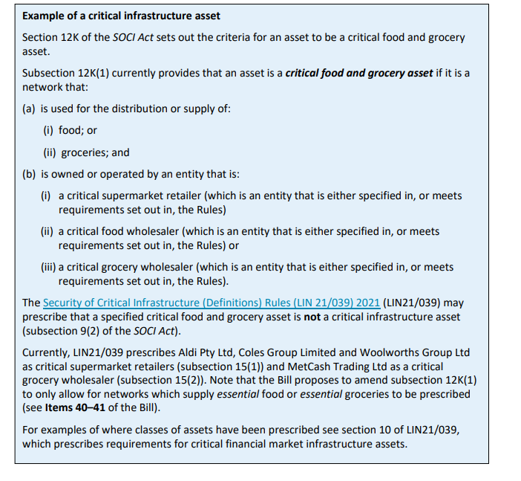
But delegated legislation is also relevant here See Security Legislation Amendment (Critical Infrastructure Protection Bill 2022 (Bills Digest No 55 2021-22 https://parlinfo.aph.gov.au/parlInfo/download/legislation/billsdgs/8492437/upload_binary/8492437.pdf;fileType=application%2Fpdf#search=%22legislation/billsdgs/8492437%22

Slide 30
What did the the oririnal Act do
According to Department of Home Affairs to the PJCIS the Act does three things
Established a ‘Register of Critical Infrastructure Assets’ (s 19)
Gives the Government a power to collect more information about who owns/operates critical infrastructure sets (s 23)
Gives the Minister of Home Affairs a power to issue ‘directions’ to deal with ‘significant national security concerns’
Department of Home Affairs submission into the Review of the Security Legislation Amendment (Critical Infrastructure) Bill 2020 and Statutory Review of the Security of Critical Infrastructure Act 2018 (Submission to the PJCIS) (12 February 2021) (submission 59) p 6 <https://www.aph.gov.au/Parliamentary_Business/Committees/Joint/Intelligence_and_Security/CriticalInfrastructure/Submissions>

Slide 31
Obligation to give information to the Register
S 23 (2) The entity must give the Secretary the following information in accordance with subsection (3):
(a) if the reporting entity is the responsible entity for the asset—the operational information in relation to the asset;
(b) if the reporting entity is a direct interest holder in relation to the asset—the interest and control information in relation to the entity and the asset.
…Note 2: For an exception to this section, see section 25 (information that is not able to be obtained).
Civil penalty: 50 penalty units.

Slide 32
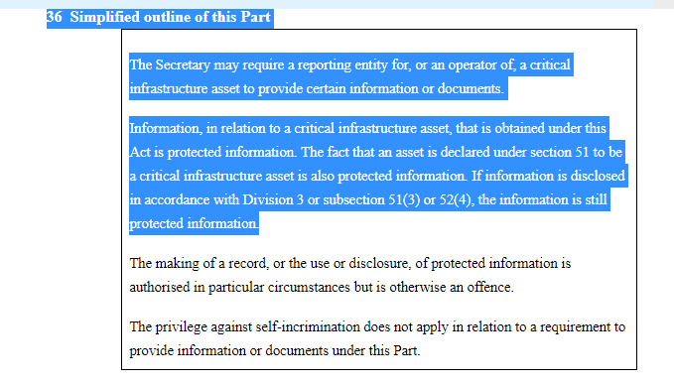
Information Gathering Power: see esp s 37

Slide 33
Directions Power
32 Direction if risk of act or omission that would be prejudicial to security
(1) This section applies if in connection with the operation of, or the delivery of a service by, a critical infrastructure asset the Minister is satisfied that there is a risk of an act or omission that would be prejudicial to security.
Direction to do, or refrain from doing, an act or thing
(2) The Minister may, subject to subsections (3) and (4), give an entity that is a reporting entity for, or an operator of, a critical infrastructure asset a written direction requiring the entity to do, or refrain from doing, a specified act or thing within the period specified in the direction.
(3) The Minister must not give the direction unless:
(a) the Minister is satisfied that requiring the entity to do, or to refrain from doing, the specified act or thing is reasonably necessary for purposes relating to eliminating or reducing the risk mentioned in subsection (1); and
(b) the Minister is satisfied that reasonable steps have been taken to negotiate in good faith with the entity to achieve an outcome of eliminating or reducing the risk without a direction being given under subsection (2); and
(c) an adverse security assessment in respect of the entity has been given to the Minister for the purposes of this section; and
(d) the Minister is satisfied that no existing regulatory system of the Commonwealth, a State or a Territory could instead be used to eliminate or reduce the risk mentioned in subsection (1).
Note: The Minister must also undertake consultation before giving a direction (see section 33).

Slide 34
Key 2021 changes
The introduction of Positive Security Obligations
Because the number of ‘critical infrastructure assets expanded’ after the 2021 amendments, new entities need to include information on the register
Part 2B of the SOCI Act now includes mandatory cyber incident reporting

Slide 35
Key 2021 changes: Mandatory cyber –incident reporting
30BA Simplified outline of this Part
If a cyber security incident has a relevant impact on a critical infrastructure asset, the responsible entity for the asset may be required to give a relevant Commonwealth body a report about the incident.
‘12M Meaning of cyber security incident
A cyber security incident is one or more acts, events or circumstances involving any of the following:
(a) unauthorised access to:
(i) computer data; or
(ii) a computer program;
(b) unauthorised modification of:
(i) computer data; or
(ii) a computer program;
(c) unauthorised impairment of electronic communication to or from a computer;
(d) unauthorised impairment of the availability, reliability, security or operation of:
(i) a computer; or
(ii) computer data; or
(iii) a computer program.

Slide 36
Key 2021 changes: Mandatory cyber –incident reporting
30BEA Significant impact
For the purposes of this Part, a cyber security incident has a significant impact (whether direct or indirect) on the availability of an asset if, and only if:
(a) both:
(i) the asset is used in connection with the provision of essential goods or services; and
(ii) the incident has materially disrupted the availability of those essential goods or services; or
(b) any of the circumstances specified in the rules exist in relation to the incident.

Slide 37
Key 2021 changes: Mandatory cyber –incident reporting
30BC Notification of critical cyber security incidents
(1) If:
(a) an entity is the responsible entity for a critical infrastructure asset; and
(b) the entity becomes aware that:
(i) a cyber security incident has occurred or is occurring; and
(ii) the incident has had, or is having, a significant impact (whether direct or indirect) on the availability of the asset;
the entity must:
(c) give the relevant Commonwealth body (see section 30BF) a report that:
(i) is about the incident; and
(ii) includes such information (if any) as is prescribed by the rules; and
(d) do so as soon as practicable, and in any event within 12 hours, after the entity becomes so aware.
Civil penalty: 50 penalty units.
Note there is a separate obligation under : 30BD Notification of other cyber security incidents

Slide 38
Key 2021 changes: Mandatory cyber –incident reporting
30BF Relevant Commonwealth body
For the purposes of this Part, relevant Commonwealth body means:
(a) a Department that is specified in the rules; or
(b) a body that is:
(i) established by a law of the Commonwealth; and
(ii) specified in the rules; or
(c) if:
(i) no rules are in force for the purposes of paragraph (a); and
(ii) no rules are in force for the purposes of paragraph (b);
ASD.

Slide 39
Key 2021 changes: Government Assistance
35AA Simplified outline of this Part
• This Part sets up a regime for the Commonwealth to respond to serious cyber security incidents.
• If a cyber security incident has had, is having, or is likely to have, a relevant impact on a critical infrastructure asset, the Minister may, in order to respond to the incident, do any or all of the following things:
(a) authorise the Secretary to give information‑gathering directions to a relevant entity for the asset;
(b) authorise the Secretary to give an action direction to a relevant entity for the asset;
(c) authorise the Secretary to give an intervention request to the authorised agency.
• An information‑gathering direction requires the relevant entity to give information to the Secretary.
• An action direction requires the relevant entity to do, or refrain from doing, a specified act or thing.
• An intervention request is a request that the authorised agency do one or more specified acts or things in relation to the asset.

Slide 40
Key 2021 changes: Government Assistance
35AB Ministerial authorisation
Scope
(1) This section applies if the Minister is satisfied that:
(a) a cyber security incident:
(i) has occurred; or
(ii) is occurring; or
(iii) is imminent; and
(b) the incident has had, is having, or is likely to have, a relevant impact on a critical infrastructure asset (the primary asset); and
(c) there is a material risk that the incident has seriously prejudiced, is seriously prejudicing, or is likely to seriously prejudice:
(i) the social or economic stability of Australia or its people; or
(ii) the defence of Australia; or
(iii) national security; and
(d) no existing regulatory system of the Commonwealth, a State or a Territory could be used to provide a practical and effective response to the incident.

Slide 41
Key 2021 changes: Government Assistance
35AC Kinds of acts or things that may be specified in an intervention request
For the purposes of the application of paragraph 35AB(10)(g) to a Ministerial authorisation of a request, each of the following kinds of acts or things is covered by this section:
(a) access or modify:
(i) a computer that is, or is part of, the asset to which the Ministerial authorisation relates; or
(ii) a computer device that is, or is part of, the asset to which the Ministerial authorisation relates;
(b) undertake an analysis of:
(i) a computer that is, or is part of, the asset to which the Ministerial authorisation relates; or
(ii) a computer program that is, or is part of, the asset to which the Ministerial authorisation relates; or
(iii) computer data that is, or is part of, the asset to which the Ministerial authorisation relates; or
(iv) a computer device that is, or is part of, the asset to which the Ministerial authorisation relates;
(c) if it is necessary to achieve the purpose mentioned in paragraph (b)—install a computer program on a computer that is, or is part of, the asset to which the Ministerial authorisation relates;

Slide 42
Key 2021 changes: Government Assistance
This was quite a controversial part of the 2021 reforms
Note some safeguards
Minister can only exercise this power ‘personally’ (35AJ)
The Government has said repeatedly that this is a mechanism of ‘last resort’
35BK Reports to the Parliamentary Joint Committee on Intelligence and Security
(1) If the Secretary gives one or more directions under section 35AK or 35AQ, or one or more requests under section 35AX, in relation to a cyber security incident, the Secretary must give the Parliamentary Joint Committee on Intelligence and Security a written report about the incident.
(2) The report must include a description of each of the directions or requests.

Slide 43
So what happened in 2022: Critical Infrastructure Risk Management Plans
Part 2A of SOCI -
30AA Simplified outline of this Part
• The responsible entity for one or more critical infrastructure assets must have, and comply with, a critical infrastructure risk management program (unless an exemption applies).
• The purpose of a critical infrastructure risk management program is to do the following for each of those assets:
(a) identify each hazard where there is a material risk that the occurrence of the hazard could have a relevant impact on the asset;
(b) so far as it is reasonably practicable to do so—minimise or eliminate any material risk of such a hazard occurring;
(c) so far as it is reasonably practicable to do so—mitigate the relevant impact of such a hazard on the asset.
• A responsible entity must give an annual report relating to its critical infrastructure risk management program. If the entity has a board, council or other governing body, the annual report must be approved by the board, council or other governing body.

Slide 44
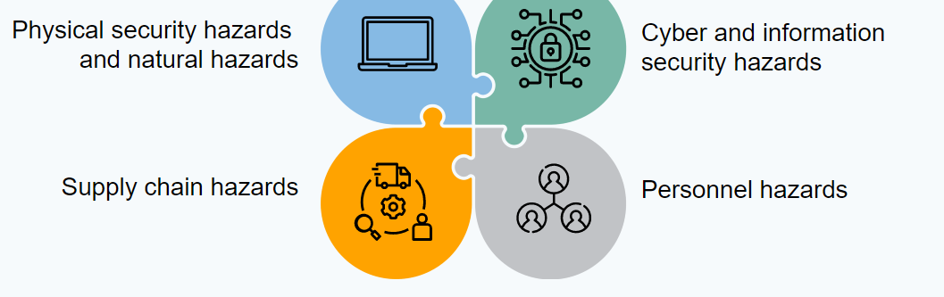
Critical Infrastructure Risk Management Plans Not restricted to Cyber threats

Slide 45
More Cyber obligations for ‘Systems of National Significance’
Division 1—Simplified outline of this Part
30CA Simplified outline of this Part
• This Part sets out enhanced cyber security obligations that relate to systems of national significance.
• The responsible entity for a system of national significance may be subject to statutory incident response planning obligations.
• The responsible entity for a system of national significance may be required to undertake a cyber security exercise.
• The responsible entity for a system of national significance may be required to undertake a vulnerability assessment.
• If a computer is a system of national significance, or is needed to operate a system of national significance, a relevant entity for the system may be required to:
(a) give ASD periodic reports of system information; or
(b) give ASD event‑based reports of system information; or
(c) install software that transmits system information to ASD.

Slide 46
Systems of National Significance
52B Declaration of systems of national significance by the Minister
(1) The Minister may, in writing, declare a particular asset to be a system of national significance if:
(a) the asset is a critical infrastructure asset; and
(b) the Minister is satisfied that the asset is of national significance.
(2) In determining whether an asset is of national significance for the purposes of subsection (1), the Minister must have regard to:
(a) the consequences that would arise for:
(i) the social or economic stability of Australia or its people; or
(ii) the defence of Australia; or
(iii) national security;
if a hazard were to occur that had a significant relevant impact on the asset; and
(b) if the Minister is aware of one or more interdependencies between the asset and one or more other critical infrastructure assets—the nature and extent of those interdependencies; and
(c) such other matters (if any) as the Minister considers relevant.
(3) The Minister must notify the following of the declaration, in writing, within 30 days after making the declaration in relation to an asset:
(a) each reporting entity for the asset;
(aa) the Parliamentary Joint Committee on Intelligence and Security;
(b) if the asset is a tangible asset located (wholly or partly) in a State, the Australian Capital Territory or the Northern Territory—the First Minister of the State, the Australian Capital Territory or the Northern Territory, as the case requires.
(4) A declaration under subsection (1) is not a legislative instrument.
(5) To avoid doubt, an asset may be the subject of a declaration under subsection (1) even if the asset is not a system.

Slide 47
Systems of National Significance
There must be consultation before a ‘System of National Significance Declaration can be made (see s 52C)
And they can be reviewed (internally by the department) (see s 52E)

Slide 48
‘Enhanced Cyber Security Obligations for Systems of National Significance
According to Gilbert +Tobin Four key things can be done under Part 2C of the Act
May need to do an ‘incident response plan’
Might be required to undertake ‘cyber security exercises’
Might need to assess ‘vulnerabilities’
Might need to give ASD certain information or report to certain information.
There are penalties if a system of national significance does not comply with this

Slide 49
Overall reporting requirements
Reporting requirements for the use of the Act are found in s 60
(Secretary of the Department [of Home Affairs] must give the Minister [of Home Affairs] reports on a number of aspcfs of the operation of the act. These reports need to be tabled in Parliament
As of 2022 there will be an Indpendent Review of the Act (12 Months after the 2022 act commences
The PJCIS will review the Act 3 years after the 2021 Act receives royal assent.

Slide 50
Activity after the Break
When we have returned from the break (approx. 3:45) I will divide the class into five groups. In your groups could you please discuss the following questions
Why adopt an ‘all hazards’ approach when trying to ensure that critical infrastructure is kept ‘secure’? Are there risks in doing so? What are the particular challenges for cyber law in adopting such an approach?
Imagine you represent one of the ‘critical infrastructure sectors’ (you can pick which one). Name one or two aspects of the development of the current SOCI framework that you think worked well? What would your ‘top two tips’ be for government as they continue to provide guidance or consultation into the future
Should the government have tried to regulate cyber challenges separately from other risks to critical infrastructure? Why or why not?
Again assume you represent one of the critical infrastructure sectors.What are two challenges that your group can identify around complying with this legislative framework? Be ready to explain why you chose the ones you did, and explain how you would try and meet that challenge?

